Slide 1
Voice Process
English 10

Slide 2
How is your voice produced?
If we do not breathe, we cannot talk.
Humans speak on a stream of exhaled air.
A tense body will not fuel the speech mechanism as well as a relaxed one.

Slide 3
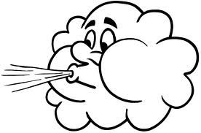
Three things happen to the exhaled stream of air to create a recognizable speech sound.
This is known as the Voice Process.

Slide 4
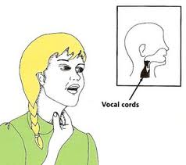
The voice process notes
Phonation
Vibration of the vocal cords as air passes over them.
The stronger the burst of air, the louder the sound.

Slide 5
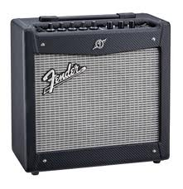
The voice process notes
2. Resonation
Amplification of the
speech sound.
The sound bounces around the mouth, nasal cavities, and sinuses. This amplifies or strengthens the sound.

Slide 6
The voice process notes
3. Articulation
Changes the amplified sound into an actual word by molding it into letter sounds.
The sounds emerge as words.
END OF THE VOICE PROCESS

Slide 7
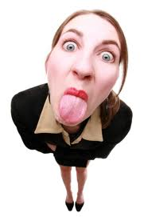
Terms To Know
Articulation:
Making each word clear.
The tongue is the workhorse of the articulators.

Slide 8
Terms To Know
Inflection:
Varying the tone of your voice during words and sentences. This allows your voice to be expressive and interesting.
MONOTONE

Slide 9
Things that can cause vocal production problems
Head cold Posture
Broken rib Chewing Gum
Missing teeth
Swollen tongue
Sinus Congestion
Broken jaw
Chest congestion
Swollen vocal cords
(laryngitis)

