Slide 1
Unit 7
The Language of Poetry

Slide 2
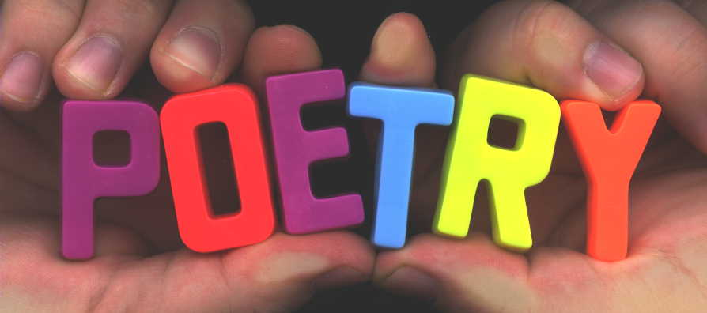
The Language of Poetry
Emily Dickinson once wrote, “If I feel physically as if the top of my head were taken off, I know that is poetry.”
A good poem can make readers look at the world in a new way.
Read a poem closely, and you will see how it has been carefully crafted to impact you.

Slide 3
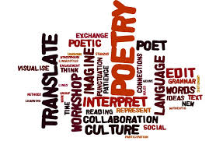
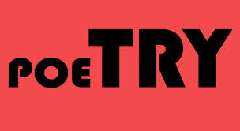
Key Terms
A poem’s structure is known as its form.
All poems are made up of a series of lines.
The lines of many poems are grouped together in stanzas.

Slide 4
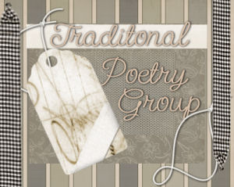
Key Terms
The category of poetry that follows fixed rules is called Traditional.
The category of poetry that does not follow set rules is called Organic.

Slide 5
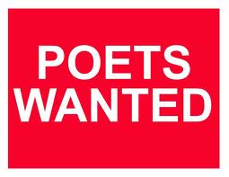
I. Traditional Poetry
A. Characteristics
1. Follows fixed rules, such as a specified number of lines
2. Has regular rhythm and rhyme

Slide 6
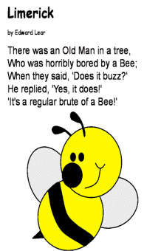
Traditional Poetry
B. Forms of Traditional Poetry
1. sonnet
2. ode
3. haiku
4. limerick
5. ballad
6. epic

Slide 7
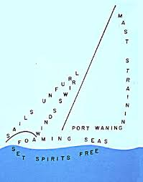
II. Organic Poetry
A. Characteristics
1. irregular rhythm; may not have rhyme
2. may use unconventional spelling, punctuation, and grammar
B. Forms of Organic Poetry
1. free verse
2. concrete poetry
Turn to page 689

Slide 8
Poetic Elements
1. Rhythm – the pattern of stressed and unstressed syllables in each line of poetry
2. Meter – regular pattern of rhythm
3. Scanning – marking the meter of the poem
4. Rhyme scheme – a regular pattern of rhyme

Slide 9
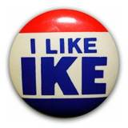
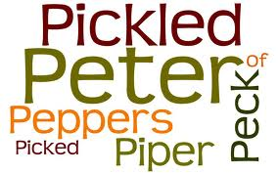
Poetic Elements
5. Repetition – a sound, word, phrase, or line that is repeated for emphasis and unity
6. Assonance – repetition of vowel sounds in words that don’t end with the same consonant
7. Alliteration – the repetition of consonant
sounds at the beginnings of words
8. Consonance – the repetition of consonant sounds within and at the ends of words
Turn to page 690

Slide 10
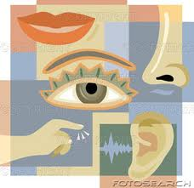
Review of Imagery and Figurative Language
Imagery – words or phrases that re-create sensory experiences
Figurative Language – conveys meanings beyond the literal meanings of words
Turn to page 692

Slide 11
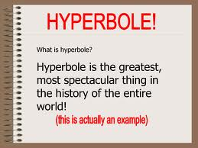
Review of Imagery and Figurative Language
Simile – a comparison between two unlike things using the words like, as, or as if
Metaphor – a comparison between two unlike things but without the words like or as
Personification – a description of an object, an animal, a place, or an idea in human terms
Hyperbole – an exaggeration for emphasis or humorous effect
Turn to page 694

