Slide 1
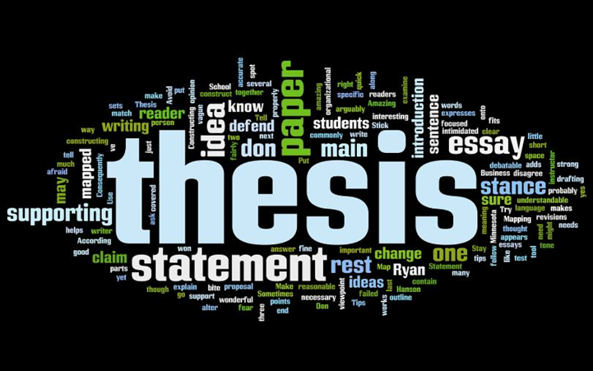
Thesis Statements

Slide 2
Thesis Statements
Nonfiction compositions, such as research papers, begin by telling readers what they will encounter in the text.
An introduction to a research paper contains a thesis statement –
  a one or two sentence statement identifying the composition’s:
      Topic
      Main idea
      Purpose

Slide 3
A Thesis Statement:
Builds reader interest
Helps a reader know what to expect
Clarifies the writer’s purpose
Helps a writer focus the composition
Helps a writer check that necessary information is included
Helps a writer make edits- cuts and additions to – the composition

Slide 4
Thesis Statements
Incorrect Examples:
Last week, the school board agreed on a plan to station police officers in the hallways at Parker High School.
  A thesis statement should not be a simple statement of fact.
Using city police as “resource officers” in the hallways of Parker High School is a first step down the terrifying road to totalitarianism.
  A thesis statement should not express sweeping opinions.
  Overemotional tone

Slide 5
Thesis Statements
Correct Example:
Stationing police officers in our high school hallways is a misuse of city resources and sends the unfair message that students are not to be trusted.
  A thesis statement should make a point that can be supported by evidence.

Slide 6
Thesis Statements
☹ Bad: iPods are devices that transport and play music.
☺ Good: iPods are the best source for transporting and playing music not only because they are compact and user-friendly but also because they store large amounts of music.

Slide 7

KINDS OF THESIS STATEMENTS
The enumerative thesis (a.k.a. “three-point” thesis) lists the evidence that supports your primary argument. Each body paragraph discusses one piece of evidence.
  Example: The writers of Family Guy use irreverent humor to satirize pop culture, comment on the stereotypical American family, and explore controversial themes.

Slide 8

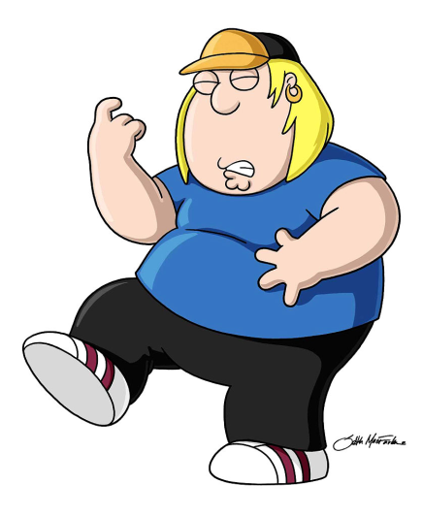

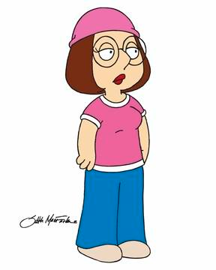
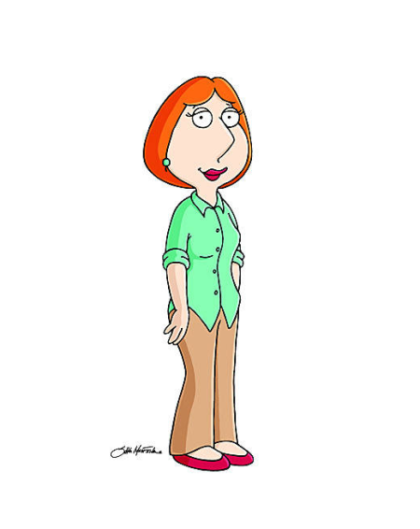

Enumerative Thesis
Though three points are commonly used, writers should use as many supporting ideas as they deem necessary.

Slide 9
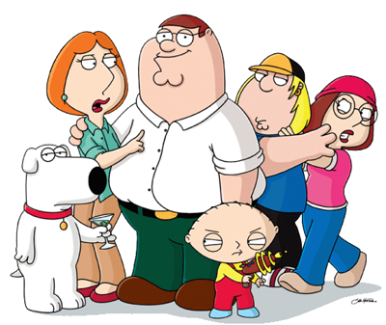
KINDS OF THESIS STATEMENTS
The umbrella thesis encompasses the entire argument in a concise statement without naming each piece of evidence that the author plans to use.
  Example: The irreverent humor used in Family Guy is not simply for shock value; the writers are commenting on much deeper societal issues.

Slide 10

HOW TO DEVELOP A THESIS STATEMENT
Think deeper! After writing a thesis statement, ask yourself, “So what?”
  Example: Family Guy is a humorous television show. (So what?)
  Revision: Family Guy is entertaining because of its controversial humor. (So what?)
  Revision: The irreverent humor used in Family Guy is not simply for shock value; the writers are exploring much deeper societal issues.

Slide 11
ways to expand your thesis
Say why:
  For many student writers, procrastination is based on fear; this fear keeps students from improving their writing because they do not take the time to fully develop their ideas.

Slide 12
ways to expand your thesis
Say why your audience should care:
  Students should understand that worrying about grammar and spelling too early in the writing process will actually lead to a poor essay.

Slide 13
ways to expand your thesis
Say how:
  English teachers often overwhelm students by giving them too many tasks to think about when writing essays.

Slide 14
ways to expand your thesis
Make specific comparisons:
  The key difference between writing in high school and writing in college is that your ideas become more significant and complex; therefore, college freshman have to learn to think critically.

Slide 15
ways to expand your thesis
Make an evaluation:
  My high school teacher’s insistence on teaching me the five paragraph essay has actually hurt my writing skills.
Consider the consequences:
  If students do not find ways to think deeper and more critically, they will never learn to fully develop their ideas.

Slide 16
TOPIC SENTENCES
Just as the thesis statement tells the main argument of your essay, topic sentences state the main idea of individual body paragraphs and directly relate to your thesis.
Topic sentences provide support for your argument and direction for your reader.

Slide 17





The Solar System Analogy
Just as the sun is the center of the solar system and orbited by the planets, topic sentences revolve around your thesis statement, the center of your argument.
Thesis
Topic Sentence

Slide 18
The Roof and Pillar Analogy
The thesis statement covers the overall argument/primary point of the paper and is supported by the topic sentences, which give the main points and evidence of the paper.

