Slide 1
The Canterbury Tales
Unit One, Part Two – British Literature English 12

Slide 2
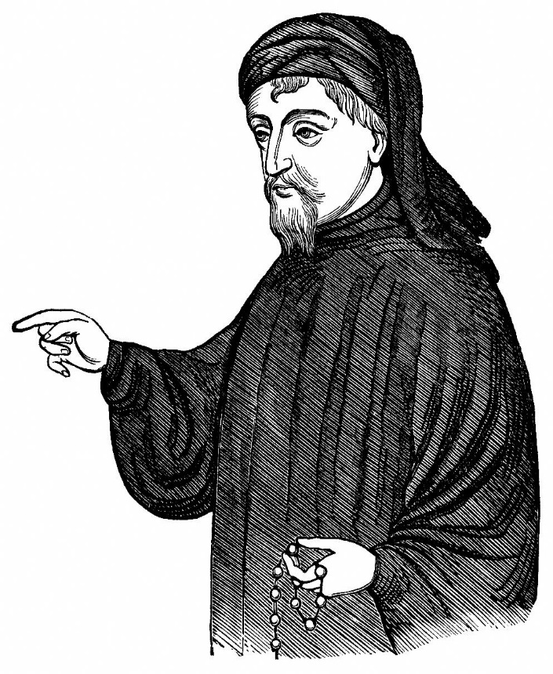
Geoffrey Chaucer (1343-1400)
Chaucer was known as the father of English poetry.

Slide 3
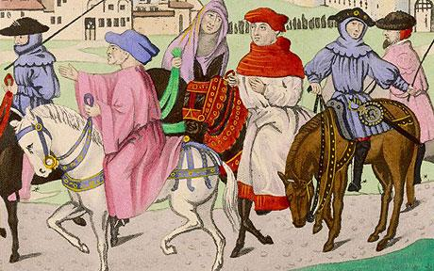
During his life…
Chaucer served in a number of highly responsible positions, which exposed him to the whole spectrum of the medieval society we see in the Tales.

Slide 4
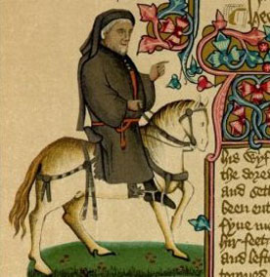
Chaucer was a brilliant poet who knew how to laugh at human folly.
He even knew how to laugh at himself; his portrayal of himself as one of the pilgrims is of a short, plump, slightly foolish man who commands no great respect.

Slide 5
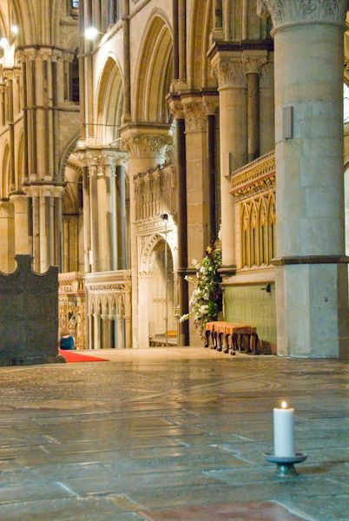
The Tales
Chaucer completed 24 of the 120 tales that would have been told if each pilgrim had told four tales.

Slide 6
Each tale had a MORAL.
The lesson about human nature a story teaches.

