Slide 1
Methods of Persuasion
English 10

Slide 2
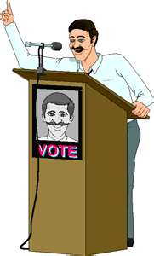
Methods of Persuasion
What makes a speaker persuasive?
Why do listeners accept one speaker’s views and reject those of another speaker?

Slide 3
Methods of Persuasion
People have been trying to answer these questions since the days of the ancient Greeks.
Although many answers have been given, we can say that listeners will accept a speaker’s ideas for one or more of the following four reasons:

Slide 4
1. Building Credibility
A speaker’s credibility is influenced by two factors:
A. Competence – how an audience regards a speaker’s intelligence and knowledge of the subject.
B. Character – how an audience regards a speaker’s sincerity, trustworthiness and concern for the well being of the audience.

Slide 5
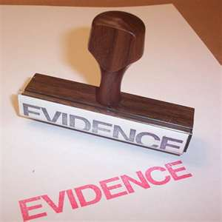
2. Using Evidence
Evidence consists of supporting materials – examples, statistics, and testimony – used to prove or disprove something. If you hope to be persuasive, you must support your views with evidence. Whenever you say something that is open to question, you should give evidence to prove you are right.
Evidence also enhances your credibility.

Slide 6
3. Using Reasoning
Reasoning is simply the process of drawing a conclusion based on evidence.

Slide 7
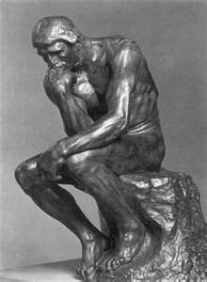
As a public speaker you have two major concerns with respect to reasoning.
First, you must make sure your reasoning is sound.
Second, you must try to get listeners to agree with your reasoning.
You need to make it listener- friendly.

Slide 8
4. Appealing to Emotions
Emotional appeals are intended to make listeners feel sad, angry, guilty, afraid, happy, proud, or nostalgic. These are often appropriate reactions when the question (topic) is one of value or policy. Few people are moved to change their attitudes or take action when they are complacent or bored.

Slide 9
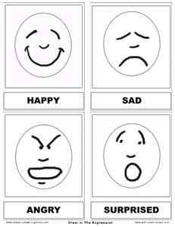
Appealing to Emotions
One way to generate emotional appeal is to use emotion-laden words: murder, dictatorship, religious fanaticism, mob violence, brutal torture, censorship, loss of freedom, civil rights, America!

Slide 10
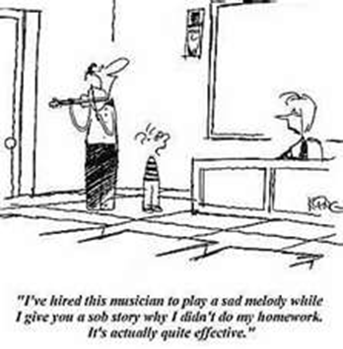
How will you persuade your audience?

