Slide 1
The Catcher in the Rye
Background Information

Slide 2
J.D. Salinger
Jerome David Salinger was born in New York on January 1, 1919.
Scotch-Irish mother
Jewish father, worked as in importer (cheese and ham)
Attended the progressive McBurney School on the Upper West Side, but he flunked out after two years.
Sent to Valley Forge Military Academy (1934).
Manager of school fencing team.
Literary editor of the school yearbook.
Further education was erratic—three different colleges.

Slide 3
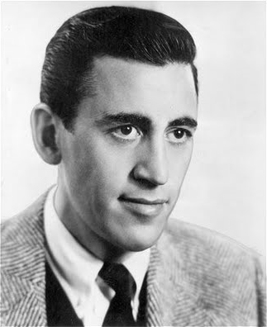
J.D. Salinger
Worked as an entertainer on a Swedish liner in the Caribbean (1941).
Served in the U.S. Army, earning five battle stars (1942-1946).

Slide 4
J.D. Salinger
Married a French physician (1945).
Divorced in 1947
Remarried and had two children (1955).
Divorced again in 1967.

Slide 5
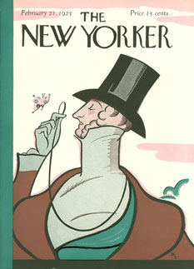
Salinger’s Writing
First story published in Story magazine in 1940.
Also wrote stories for Mademoiselle, Good Housekeeping, and Colliers.
Was writing exclusively for The New Yorker by 1958.

Slide 6
J.D. Salinger
Salinger has earned lasting acclaim; however…
He is a notorious recluse who shuns interviews.
Hasn’t published anything since 1965.
Famous for not wanting to be famous, Salinger died in January 27, 2010 at age 91 at his home in Cornish, N.H., where he had lived in seclusion for more than 50 years.

Slide 7
Young Adult genre
Considered one of the first
“YA” novelists.
Widely regarded as a spokesperson for young people after World War II.
Sharp ear for dialogue
Sensitivity to the frustrations of teens growing up in contemporary America.

Slide 8
Controversial
Because of the raw language in his books, his work was banned for a time in South Africa and Australia.
The Catcher in the Rye earned him wide praise.
It is still both one of the most frequently taught and one of the most widely censored books in American high schools.

Slide 9
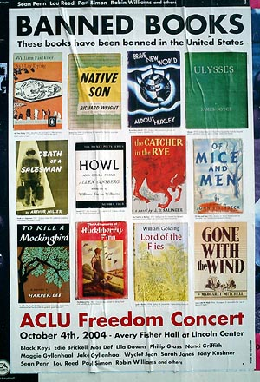
Controversy
The Catcher in the Rye was the 10th most frequently challenged book from 1990-1999 (American Library Association).
It was one of the ten most challenged books of 2005.

Slide 10
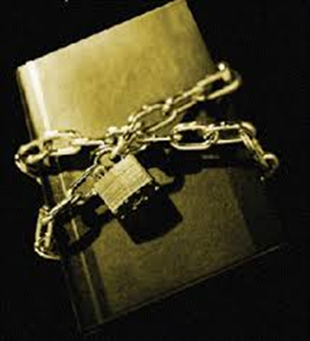
Controversy
Although it had been off the list for three years, it reappeared on the list of most challenged books of 2009.
vulgar language
sexual references
blasphemy
undermining of family values
and moral codes
Holden's being a poor role model
encouragement of rebellion
promotion of drinking, smoking, lying, and promiscuity

Slide 11
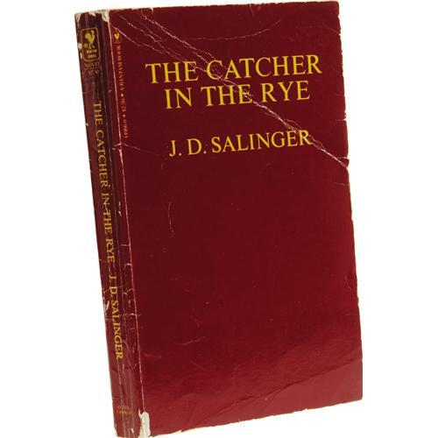
Controversy
John Hinckley, Jr. (attempted to assassinate President Ronald Reagan in 1981) was reported to have been obsessed with the book.
Mark David Chapman (murderer of John Lennon) was carrying his worn personal copy of the book when he was arrested immediately after the murder and referred to it in his statement to police shortly thereafter.
Inside he had written, "Dear Holden Caulfield, From Holden Caulfield, This is my statement“.

Slide 12
Cultural References-Films
In Annie Hall (1977), Woody Allen says that he only has books with the word death or dying in them. Diane Keaton holds a copy of The Catcher in the Rye and says, "What about this one?"
In The Shining (1980), Wendy is seen reading the novel, a foreshadowing of alienation similar to that of Holden.
In Jerry Maguire (1996), Jerry publishes a memo the cover of which he claims has a resemblance to the cover of The Catcher in the Rye.

Slide 13
Cultural References-Films
The 1988 film Field of Dreams is based on the W. P. Kinsella book Shoeless Joe. In the film, one key subplot involves the main character, Ray Kinsella (played by Kevin Costner), kidnapping noted radical book author Terence Mann (played by James Earl Jones). The Mann character is described as having written some of the most controversial books of the 1960s.
In Shoeless Joe, the Kinsella character actually kidnaps Salinger. According to the DVD extras, Salinger begrudgingly allowed his namesake to be used as a character in the book, but asked that he not be portrayed on film in Field of Dreams. So the producers and screenwriter, in consultation with the author Kinsella, changed the Salinger role to that of the fictional Mann.
In a direct homage to the book, the Mann character initially denies, then admits, about using the name John Kinsella in one of his short stories.
Salinger used both the name Ray Kinsella in a short story, and later the name Richard Kinsella as one of Holden Caulfield's classmates in The Catcher in the Rye.

Slide 14
Cultural References-Films
In Chasing Amy (1997) and Jay and Silent Bob Strike Back (2001), there are characters named Holden McNeil and Banky Edwards, the latter of whom is named after Ed Banky, the gym teacher in the novel.
In Conspiracy Theory (1997), Mel Gibson's character is programmed to buy the novel whenever he sees it, though he has never actually read it.
In Pleasantville (1998), Bud is asked by one of the teenage residents of Pleasantville what the book is about, as all literature had been out of reach to the citizens, on account of its controversial themes in that period of time. Bud tells the crowd of people what the book is about, then later it is one of the many images painted on the Police Station wall by Bud and a friend.

Slide 15
Cultural References-Films
In The Good Girl, protagonist Thomas Worther (Jake Gyllenhaal) calls himself Holden and is seen reading the novel
In Big Fat Liar (2002), Amanda Bynes's character is briefly seen tutoring a jock. Before Frankie Muniz's character walks in, she gives the jock a very brief thematic summary of The Catcher in the Rye, explaining that the story is not about "a catcher eating rye bread."
In Wedding Crashers (2005), Jeremy says that he and "the guy who wrote Catcher in the Rye," among others, are part of one being.

Slide 16
Cultural References-Films
In the film Tropic Thunder (2008), Cody Underwood (played by Danny McBride), tells John Tayback (played by Nick Nolte), the fictional author of the book Tropic Thunder, that "Tropic Thunder is my Catcher in the Rye".
Later, at the end of the film during the end credits, the song "Smoke Gets in Your Eyes" is played, the same song Holden Caulfield listens to as it's played in the final scene of The Catcher in the Rye.
In The Pursuit of Happyness (2007), the main character sees the F-word written on the wall of his son’s playgroup, along with the misspelling of Happiness as ‘Happyness’. He attempts to order it to be removed but is denied.

Slide 17
Cultural References-Television
In Saved By The Bell, Lisa asks a boy she likes, "What are you reading?" He responded with "Catcher in the Rye." Then she said, "Oh I love baseball.“
In the Boy Meets World episode "Poetic License: An Ode to Holden Caulfield", Shawn has written a poem called "An Unpublished Manuscript for J.D. Salinger". Without knowing the author, Cory asks, "And haven't we had just about enough of Catcher in the Rye? I mean, what's [Salinger] written lately?"

Slide 18
Cultural References-Television
In the Criminal Minds episode "The Last Word", both murderers use character names from the novel to communicate with each other, in reference to its alleged popularity with murderers.
In an episode of Drake and Josh, Drake is asked what his favorite 20th century novel is. He says his favorite novel is The Catcher in the Rye. His teacher responds with "Wrong."
In the episode of Fairly Oddparents, Timmy is seen bowling with books substituted for bowling pins. The Catcher In The Rye is being utilized as the front pin.

Slide 19
Cultural References-Television
In numerous episodes of Gilmore Girls, there are comparisons of Holden Caulfield and Jess, Stars Hollow's rebel. For instance, Rory says, "I guess that's what you have to do when you're trying to be Holden Caulfield".
In an episode of Roseanne, Jackie walks in on Darlene, who is reading The Catcher in the Rye and the two discuss the book in relation to Darlene's feelings that she is in Holden's situation.

Slide 20
Cultural References-Television
In The Simpsons episode "Radioactive Man" (1995), in which Hollywood movie makers come to Springfield, there is a banner hung across the main street that reads "We [heart] Phonies", presumably a reference to Holden's disdain for "phonies".
In the episodes "The Dad Who Knew Too Little" and "24 Minutes", Lisa's pet peeve is also said to be phonies.
In the episode "Krusty Gets Busted", Krusty holds a copy of the novel upside down, which refers to Mark David Chapman's arrest and obsession with the novel.
In the episode "A Midsummer's Nice Dream", when Marge becomes interested into Crazy Cat Lady's stuff, she seems happy when noticing that the Lady had in her collection all the books from J.D. Salinger except from The Catcher in the Rye.

Slide 21
Cultural References-Television
In Will & Grace, Jack asks Karen to accompany him somewhere, to which she replies, "I can't honey, I'm going to my Christian Book Club. This week we're burning The Catcher in the Rye."
Phoebe Buffay, a character from the sitcom Friends, is said to be named after Holden's sister.
In the Dawson's Creek episode “Stolen Kisses” (2000) the character William 'Will' Krudski states that The Catcher in the Rye is his favorite book.
In M*A*S*H a wounded soldier talks about the book while he is in post-op.

Slide 22
Cultural References-Books
In the The Perks of Being a Wallflower, by Stephen Chbosky, the narrator recommends this book to the reader.
In W.P. Kinsella's 1982 novel Shoeless Joe, the main character discusses the significance of "Catcher in the Rye" and later kidnaps J.D. Salinger.
In Dean Koontz's Odd Thomas, the opening paragraphs are very similar to The Catcher in Rye's.
James Patterson's novel Sail has one character referring to his nephew as "Holden Caulfield for the 21st Century".

Slide 23
Cultural References-Music
Ace of Base's single “Life Is a Flower” contains the line "No catcher in the rye, can help you from yourself."
The Ataris' song "If You Really Want to Hear About It" from their album End is Forever takes its title from the novel's opening sentence. The final lines paraphrase those of the book with "Don't ever tell anyone anything or else you'll wind up missing everybody."
Beastie Boys's song "Shadrach" contains the rhyme "Got more stories than J. D. got Salinger, I hold the title and you are the challenger."

Slide 24
Cultural References-Music
Everlast's song "So Long" contains the line "So with a tear in his eye, he's gonna catch 'em in the rye."
Green Day's song "Who Wrote Holden Caulfield?" on their album Kerplunk! is based on how frontman Billie Joe Armstrong could relate to Holden Caulfield as an outcast.
Guns N' Roses released a song on their 2008 album, Chinese Democracy called “Catcher in the Rye”. The song is said to be about Chapman.
The Offspring's song "Get It Right" contains the line "Like Holden Caulfield, I tell myself; There's got to be a better way."

