Slide 1
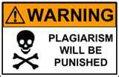
Avoiding Plagiarism
Plagiarism means using someone else’s words or ideas without giving them credit.
You must always give credit for your research information.

Slide 2
Avoiding Plagiarism
Plagiarism can be obvious, as when an essay is copied word for word, but it can also be accidental.
Accidental plagiarism occurs when a writer fails to correctly paraphrase – to rewrite information in his or her own words.
Accidental plagiarism may also occur when a writer fails to accurately cite a source.

Slide 3
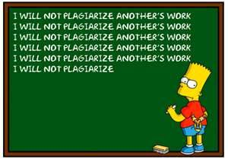
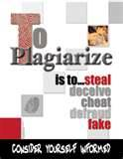
Plagiarism is BAD!

Slide 4
