Slide 1
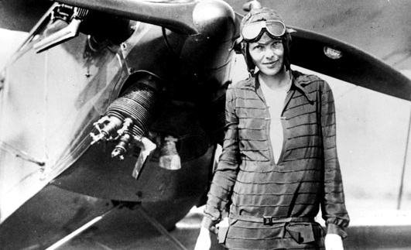
Amelia Earhart
1897-1937
“Never do things others can do and will do if there are things others cannot do or will not do.”
Amelia Earhart

Slide 2
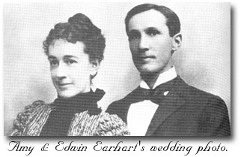
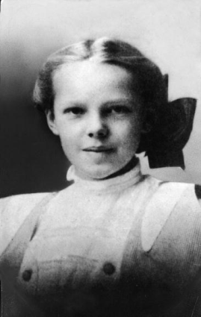
Childhood/Family Life
“Never interrupt someone doing something you said couldn't be done.”
“Better do a good deed near at home than go far away to burn incense. ”
Amelia
“Meelie”
Grace “Pidge”

Slide 3
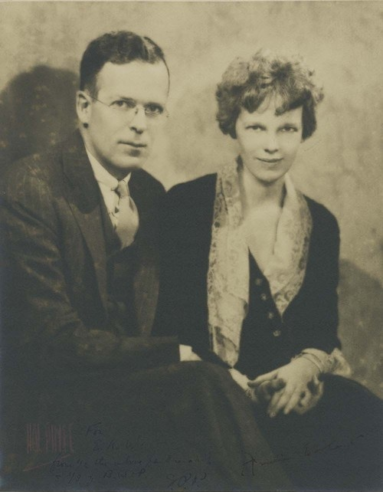
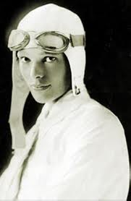
Life As A Young Adult
“Please know that I am aware of the hazards. I want to do it because I want to do it. Women must try to do things as men have tried. When they fail, their failure must be a challenge to others.”
Amelia and her husband, George Putnam, who was seven years her senior.
Young Amelia
Photo shoot

Slide 4
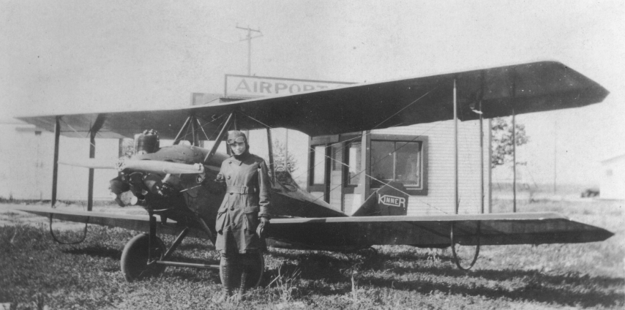
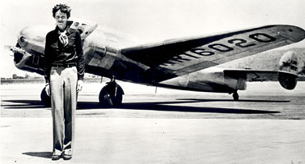
Flying Career
Kinner Airster, Amelia’s first plane,
nicknamed the “Canary”
Amelia with her
Lockheed Electra, the plane used in her last flight
“Women must pay for everything. They do get more glory than men for comparable feats, but, they also get more notoriety when they crash.”

Slide 5
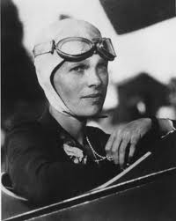
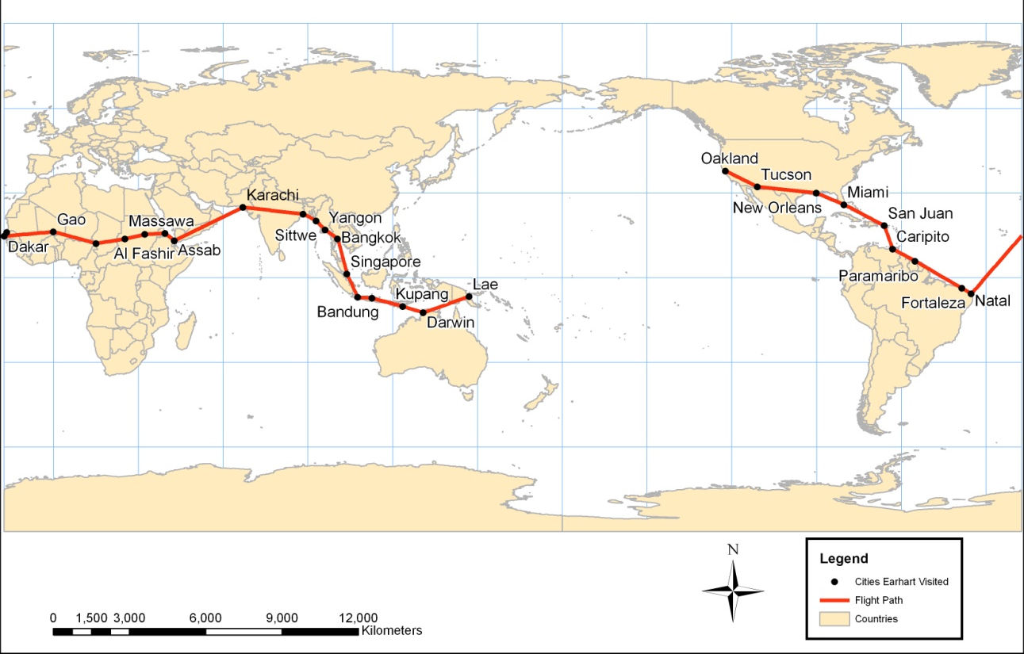
Final Flight - 1937
Amelia in flying gear
"Flying may not be all plain sailing, but the fun of it is worth the price."
Believed to have made an emergency landing on the uninhabited atoll of Nikumauroro, in the small republic of Kiribati, Amelia and Noonan may have starved to death.

Slide 6
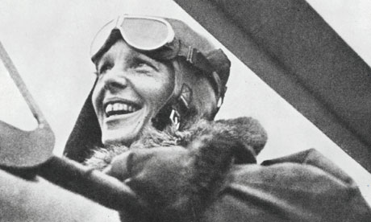
Amelia Earhart
1897-1937
"The most difficult thing is the decision to act, the rest is merely tenacity. The fears are paper tigers. You can do anything you decide to do. You can act to change and control your life; and the procedure, the process is its own reward.”
Amelia Earhart
Notes:
40 years old
20 hours to Ireland
10 am: disappeared
5 famous flights
2 people
1 life

