Slide 1
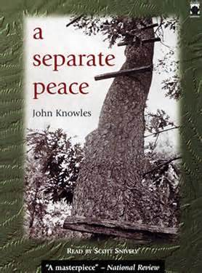
A Separate Peace
Background Information

Slide 2
Author Information
John Knowles was born in 1926 in West Virginia.
He left home at age 15 to attend Phillips Exeter Academy (an exclusive boarding school in New Hampshire, the setting that inspired A Separate Peace).
After graduating from Exeter in 1945, he spent eight months as an Air Force cadet.
Knowles then attended Yale University and graduated in 1949.

Slide 3
Author Information
He worked as a free-lance writer over the next seven years (1950-57).
A Separate Peace was published in 1959.
Other popular novels include The Paragon and Indian Summer.
Peace Breaks Out is a sequel to A Separate Peace.

Slide 4
Author & Novel Connections
When asked about how he wrote, he said that he never wrote with any audience in mind but that he was “delighted that I have found one.”
He started his novels with a sense of place; he let the writing carry him from there.

Slide 5
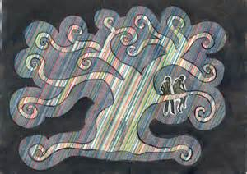
Author & Novel Connections
The plot and setting of A Separate Peace were largely inspired by Knowles’s experiences at Exeter.
Knowles was a student from the South studying in New Hampshire during World War II.
Like his characters, Knowles also attended two summer sessions in 1943 and 1944.
He participated in a club whose members had to jump out of a tall tree into a river as an initiation stunt.

Slide 6
Author & Novel Connections
Although Knowles bases many of the book’s circumstances on his own experiences, he has stated that the book’s larger themes have no factual basis.
His high school years were not plagued by the issues of envy, violence, and alienation as in the novel.
Knowles chooses to locate his characters’ difficulties not in the strict boarding-school system but within their own hearts.

Slide 7
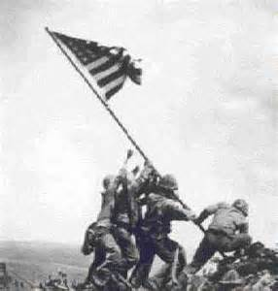
Historical Background
It’s important to understand the world situation in 1942-43:
Japan had attacked Pearl Harbor the year before, resulting in declaration of war by the United States against Japan and Germany (after those countries declared war).
In 1942, Roosevelt and Winston Churchill signed the Atlantic Charter, an 8-point declaration of principles.
In the United States, 110,000 American Japanese were moved to internment camps.

Slide 8
Historical Background
It’s important to understand the world situation in 1942-43:
The Battle of Midway, Japan’s first major defeat, occurred in June of 1942.
On August 7, the Marines landed on Guadalcanal and began to expel the Japanese.
U.S. troops invaded Italy in September of 1943 (shortly after the end of the novel).

Slide 9
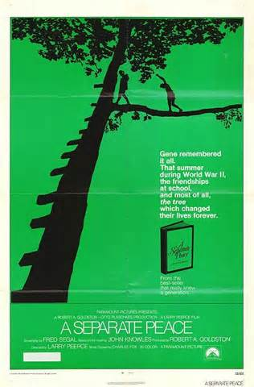
A Separate Peace
LET THE READING ADVENTURE BEGIN!

